Slide 1
Compiling kernel on linux

Slide 2
What is Kernel ?
the central or most important part of something
Interface between hardware and os
Program which control all other programs on computer.

Slide 3
Responsibility of kernel
Memory management
Process management
Device management
Disk management

Slide 4
Types of kernel
Monolithic kernel
Micro kernel

Slide 5
Monolithic kernel
Execute all operating system code in same address space.
All OS services run along with the main kernel thread.
Provides rich and powerful hardware access.

Slide 6
Micro kernel
Run OS services in user space.
Easier to maintain.
Generate more overhead.

Slide 7
Need to compile kernel
Upgrade kernel
Try new features
Hardware support
Debug
Educational purposes

Slide 8
Steps to compile kernel
Download the latest stable release from “kernel.org”
Copy the tar file to /usr/src

Slide 9
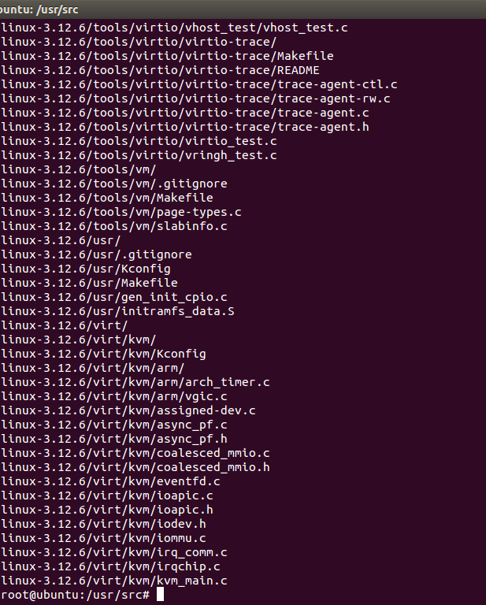
3) Untar the kernel source
tar –xvJf linux-3.12.6.tar.xz

Slide 10

4) Change directory

Slide 11
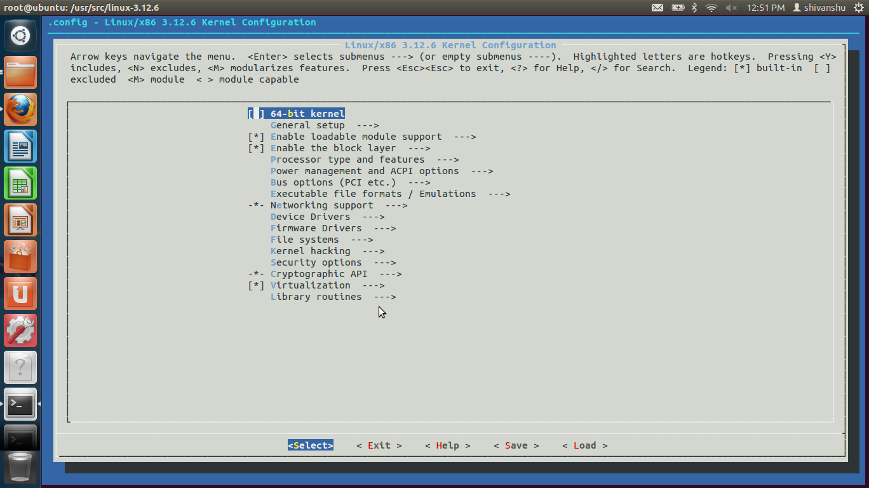
5) Configure kernel
make menuconfig

Slide 12
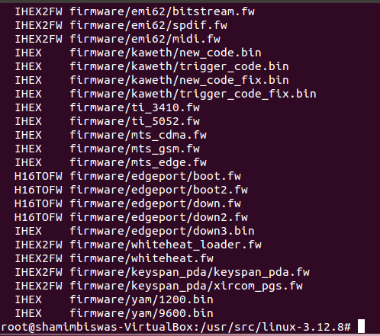
6) Compile the kernel
make

Slide 13
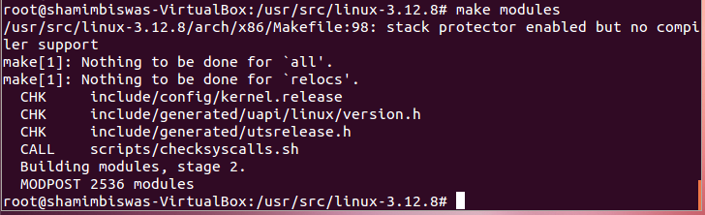

Slide 14
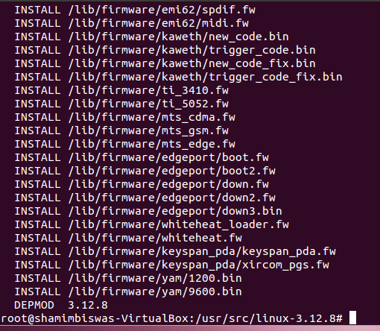

Slide 15
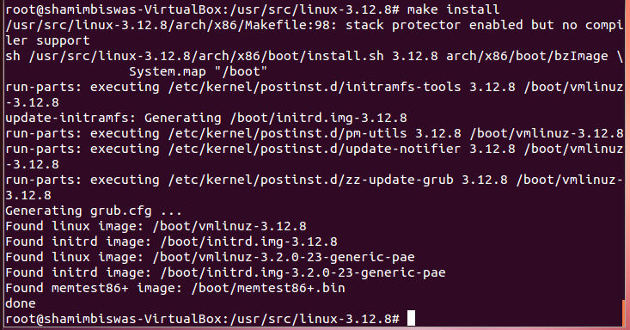
7) Install new kernel

Slide 16
8) After kernel is successfully installed, reboot the system.

Slide 17
Thank you
And
Happy compiling
☺

